Slide 1


SKIN CANCER DETECTION
ABHA SHARMA

Slide 2


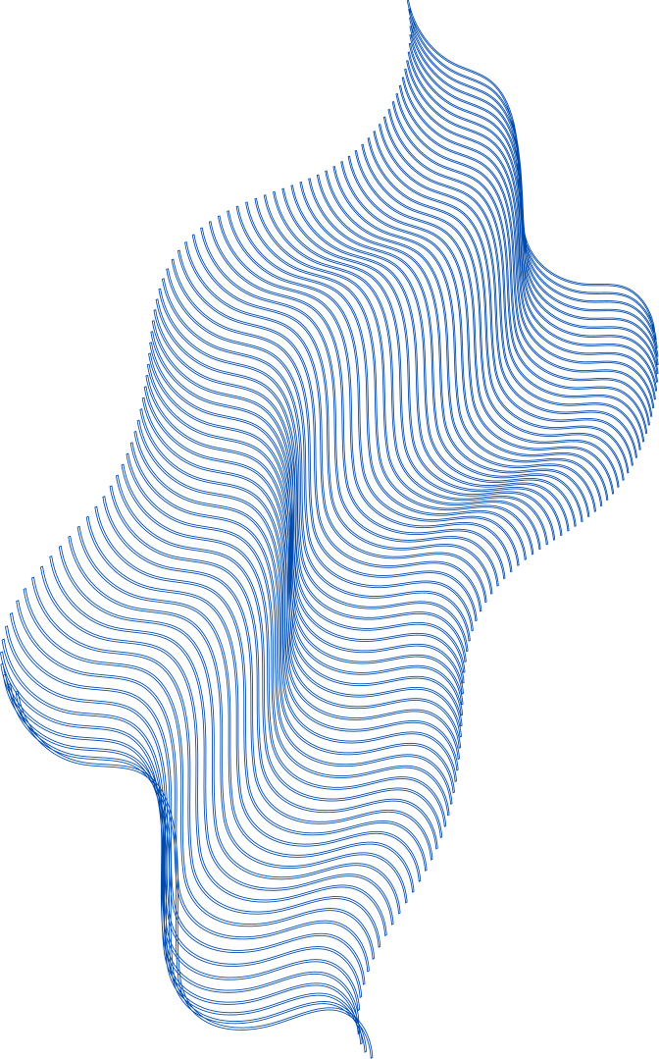
Objective
To develop an AI/ML model that can accurately detect and classify skin cancer from 3D Total Body Photography (3D-TBP) images. The model will distinguish between benign and malignant skin lesions and provide a reliable diagnostic tool for dermatologists.

Slide 3
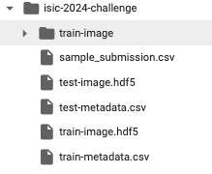
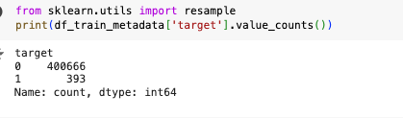
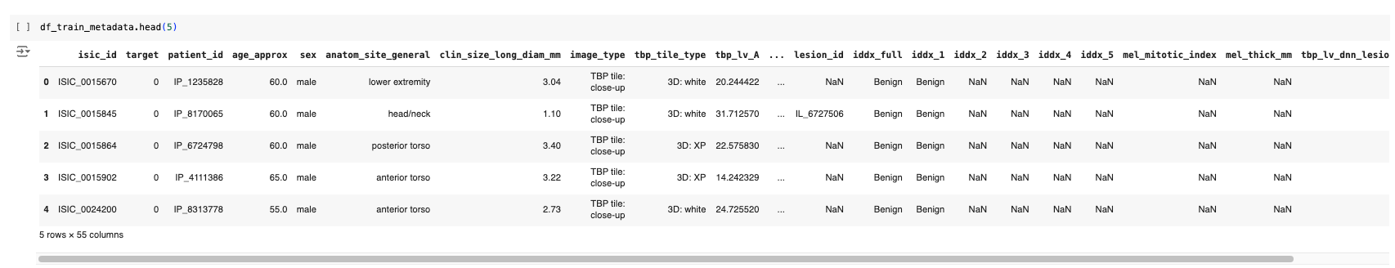
Dataset
The dataset is publicly available on https://www.kaggle.com/competitions/isic-2024-challenge

Slide 4
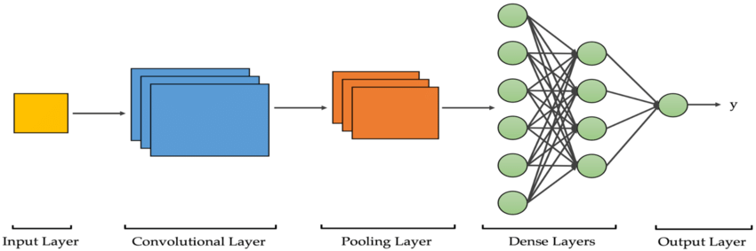
Convolutional Neural Nets
Conv. Layers uses a set of kernels to filter the input image.
Each Conv. layer is followed by a pooling layer.
The pooling layer reduces the size of the constructed feature map.This happens to recognize general patterns in the images. These general patterns are observable in resized image.
The dense (fully connected) layer plays a crucial role in the final classification or decision-making process

Slide 5


Model pipeline
Preprocessing( image re-sizing, normalization etc)
Convolutional Neural Nets
Training Data(80%)
Data preprocessing( Shuffling..)
Benign
Preprocessing( image re-sizing, normalization etc)
Trained Convolutional Neural Nets
Validation Data(20%)
Classification
Malignant
ISIC Dataset
Validation Data(20%)
Sample images

Slide 6
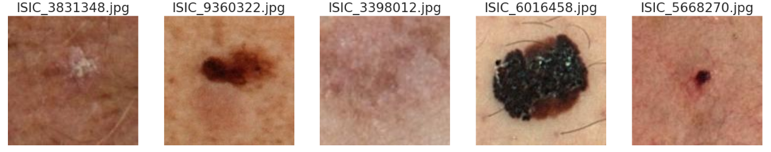
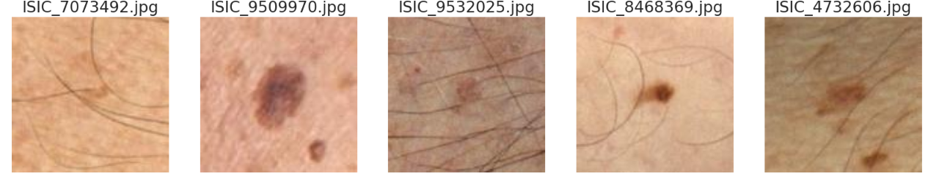
Sample Images of Benign And Malignant Cases
Malignant cases
Benign cases

Slide 7
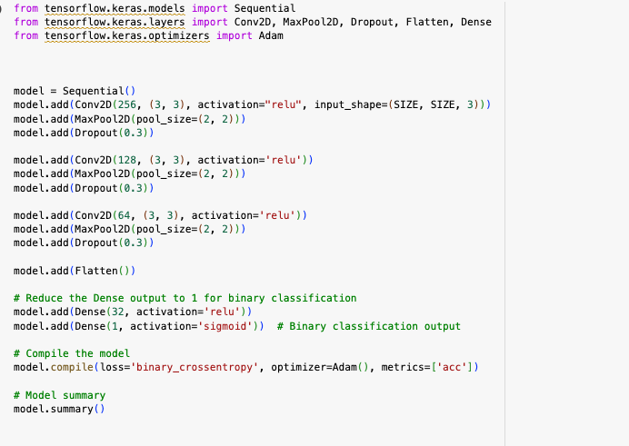
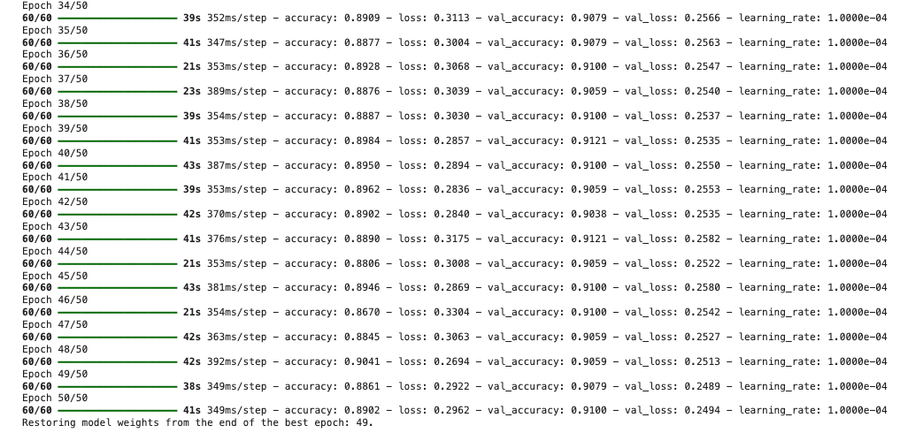
Model Training

Slide 8
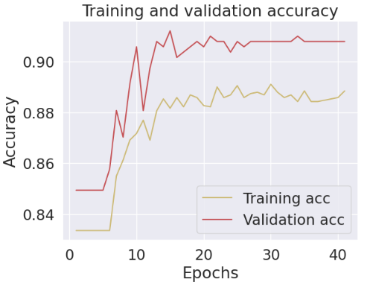
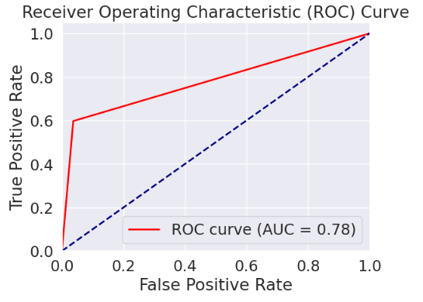
Output : Accuracy & ROC Curve

Slide 9
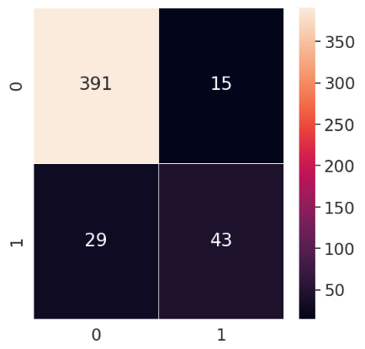
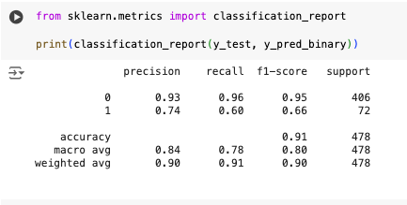
Output : Confusion Matrix

Slide 10
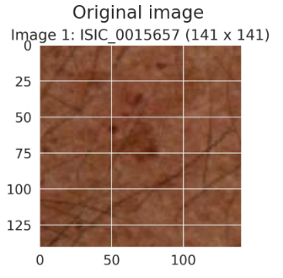
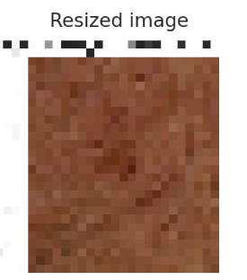

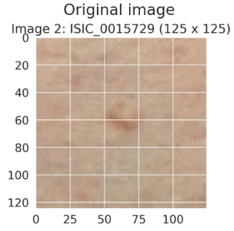
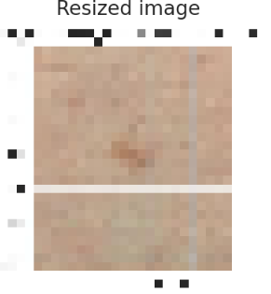
Evaluating the model : Test dataset images
Created CNN model
Created CNN model

Slide 11
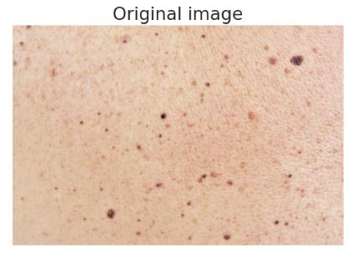
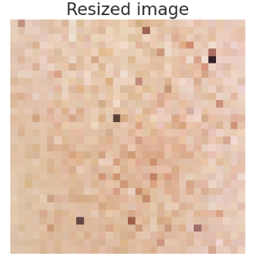

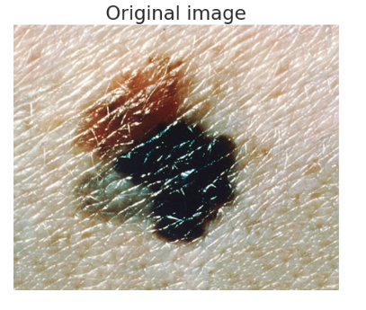
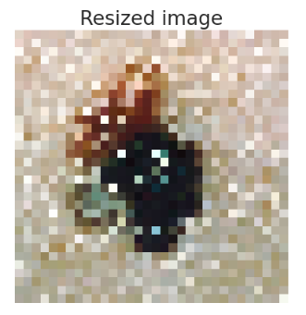
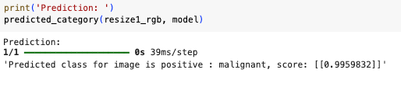
Evaluating the model : Google Images
Created CNN model
Created CNN model

Slide 12
Future Work
Model performance improvement:
Optimize model architecture : Experiment with different CNN architectures like VGG, ResNet, MobileNet, etc. to find the best performing model.
Fine-tune hyper-parameters: Adjust learning rates, batch sizes, and other training parameters for optimal performance.
Integration of cloud: AzureML, Vertex AI(GCP)
Scalability & Flexibility: Leverage cloud resources (GPU/TPU) for on-demand scalability, enabling faster training and inference without hardware limitations.
Cost Efficiency: Optimize spending with pay-as-you-go models and cost-saving options like preemptible/spot instances for non-critical tasks.
End-to-End Automation: Implement CI/CD pipelines for continuous training, testing, and deployment, accelerating model development and updates.

Slide 13
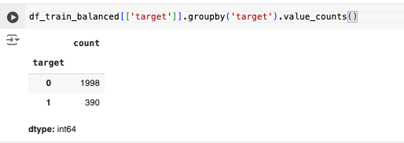
Summary
A reduced dataset of ~ 2400 images were considered for model training.
For the selected dataset, images were extracted from the training metadata set using the columns: ‘target’ and ‘isic_id’; 'target' ==1 indicating malignant cases, 'target' ==0 indicating benign cases.
The image path and sizes were stored in training dataset under columns: 'path' and 'image_pixel'.
The model achieved an overall accuracy of ~91% with AUC ~78%.

Slide 14
THANK YOU !

